Slide 1


Slide 2
Supercharging Web Development with Generative AI

Slide 3


Slide 4
🌐 Why Web Development is Important?
Everything is on the Web
From social media to shopping, from banking to learning—if it’s not on the web, it barely exists.
💡 First Impression of Any Business
Website = Digital Identity.
Just like your resume represents you, a website represents a company.
💡 Web Developers are Superheroes
They connect people, products, and services across the globe.
💡 High Demand, High Impact
Every startup, every company, every idea → needs a web presence.
💡 Innovation Playground 🚀
From AI to VR to Blockchain → web is where all cutting-edge tech lands first.

Slide 5
Generative AI
Generative AI (genAI) is a broad label describing any type of artificial intelligence (AI) that can produce new text, images, video, audio, code etc.

Slide 6
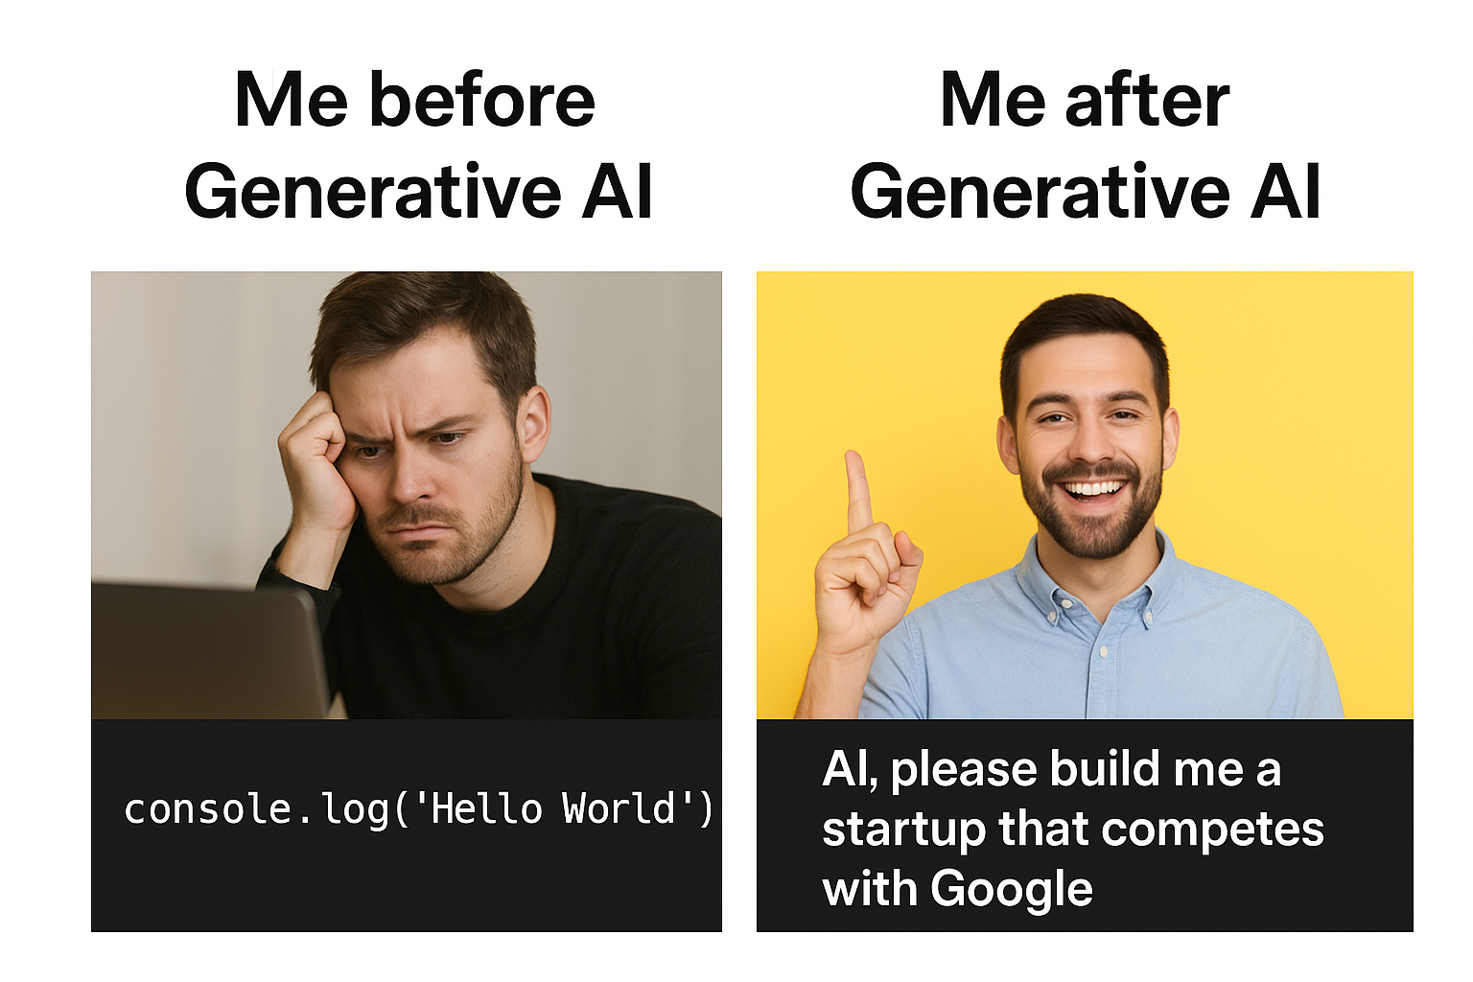

Slide 7
AI WILL NOT TAKE YOUR JOB
BUT
SOMEONE USING AI CAN TAKE YOUR JOB

Slide 8
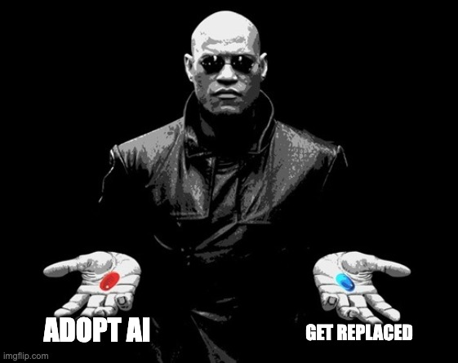

Slide 9
Survival of the Adaptive
Embracing AI to Thrive in Tomorrow's World

Slide 10
Learning Outcomes
Understand Generative AI and Prompt Engineering basics
Use Figma AI to auto-generate UI designs
Connect prompts with real web development tasks
Create a mini GenAI-powered web app
Leave with project ideas for GitHub/hackathons

Slide 11
Generative AI
Generative AI (genAI) is a broad label describing any type of artificial intelligence (AI) that can produce new text, images, video, audio, code etc.

Slide 12
Prompt Engineering
Prompt engineering is the process where you guide generative artificial intelligence (genAI) solutions to generate desired outputs.

Slide 13
Best Practices
Of
Prompt Engineering

Slide 14
Be Very Specific

Slide 15
Use Context

Slide 16
Feed Examples

Slide 17
Specify Outputs

Slide 18
Experiment

Slide 19
Examples of Gen AI Tools
GitHub Copilot: Real-time code suggestions, Multiple language support, Integrated development environment support
ChatGPT: Advanced natural language processing, Content and code generation, Image creation capabilities
Canva: AI design features, AI-powered design suggestions, Collaboration tools
Figma: AI design features, Search with a visual, Collaboration tools, Rewrite and translate with AI
Snyk: Automated vulnerability detection, Comprehensive language support, Integration with development tools.

Slide 20
Examples

Slide 21
Role of Generative AI
in
Wireframing and Prototyping

Slide 22
Why Design Matters
First impression is everything – users judge an app/website in < 5 seconds.
Bad design = less adoption even if backend is brilliant.
Good design saves dev effort – clear UI specs mean fewer iterations and less rework.

Slide 23
Use case: Create Wireframe from Meeting Notes
Tools like MS Teams or any other meeting tools generates notes based on AI.
Generate Meeting Recap.
Use Recap to generate Wireframes using Figma plugin like Ux Pilot AI

Slide 24
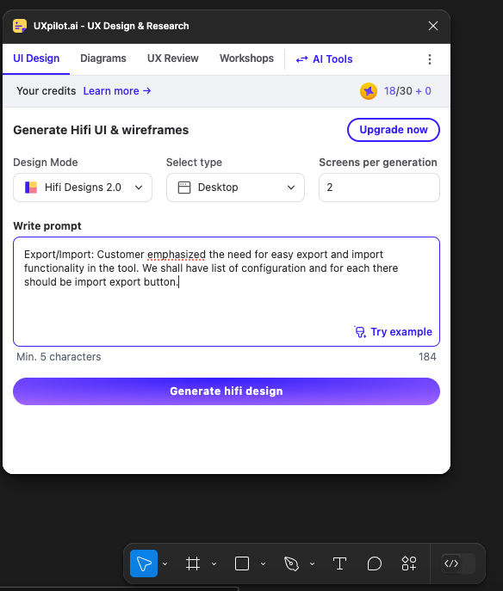
Example
Give a prompt to Plugin
Meeting Notes
Export/Import: Customer emphasized the need for easy export and import functionality in the tool. We shall have list of configuration and for each there should be import export button.

Slide 25
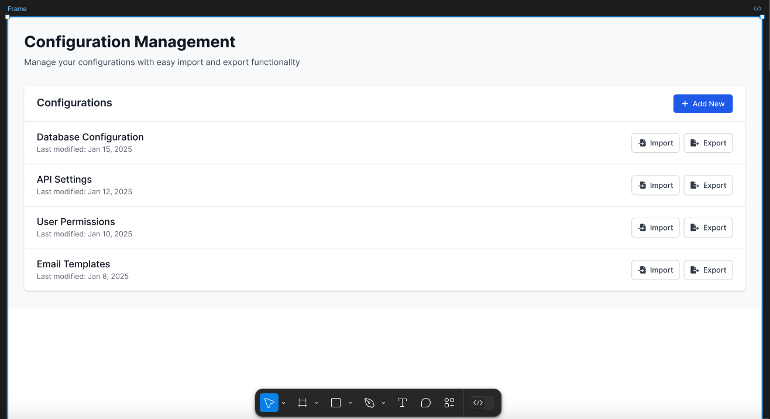
Output 1

Slide 26
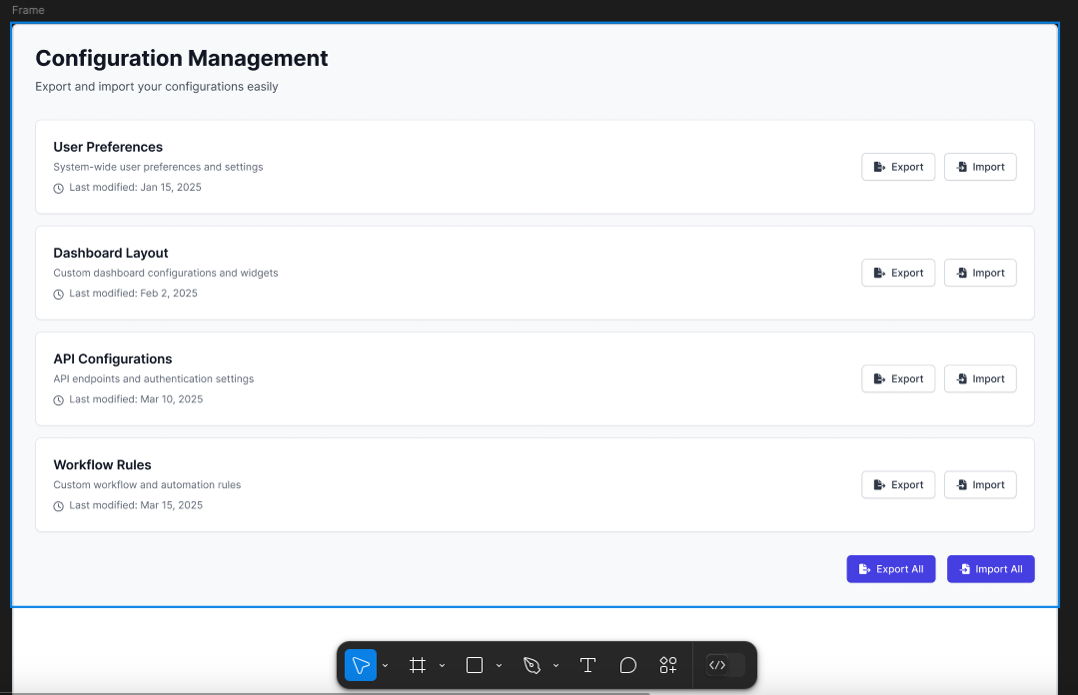
Output 2

Slide 27
Use case: Generate Images for Prototypes
Tools like MS Teams or any other meeting tools generates notes based on AI.
Generate Meeting Recap.
Use Recap to generate images for prototypes using Canva

Slide 28
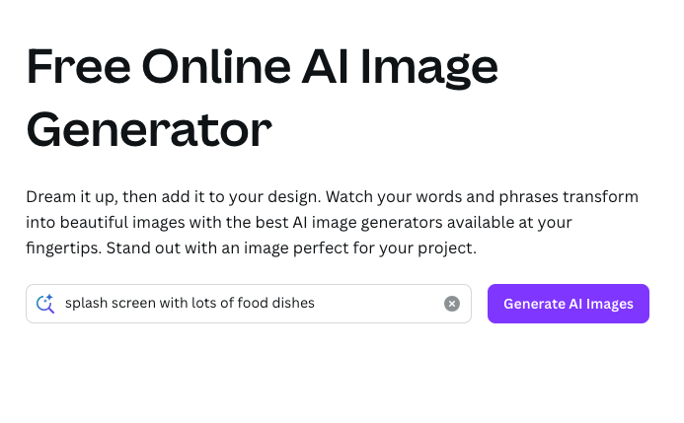
Example
Give a prompt to Plugin
Meeting Notes
Splash Screen: Customer informed that for food ordering app there should be a splash screen with lots of food dishes.

Slide 29
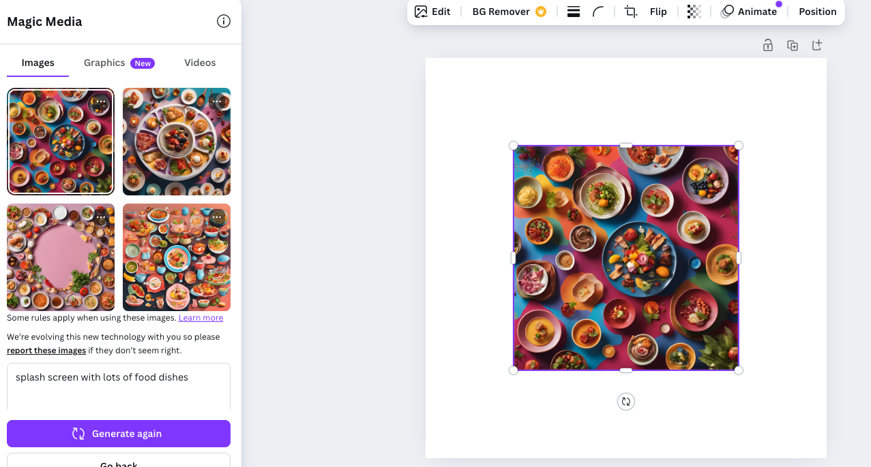
Output

Slide 30
Use case: Create prototypes for specific requirements
Based on input parameters like industry, use case, or device type, AI can suggest wireframe templates tailored to the context.
Use tools like uizard.io to generate prototypes.

Slide 31
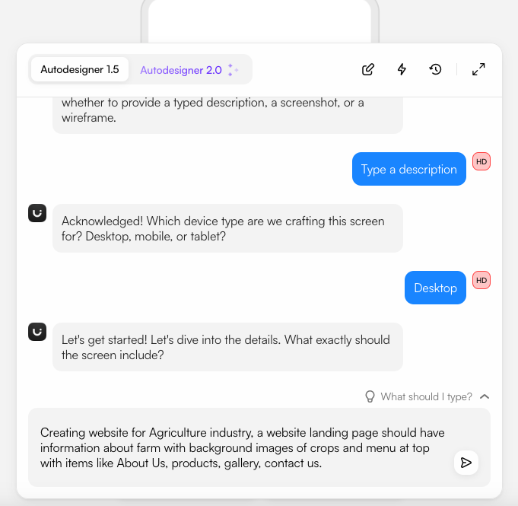
Example
Give a prompt to Plugin
Customer requirement
Creating website for Agriculture industry, a website landing page should have information about farm with background images of crops and menu at top with items like About Us, products, gallery, contact us.

Slide 32
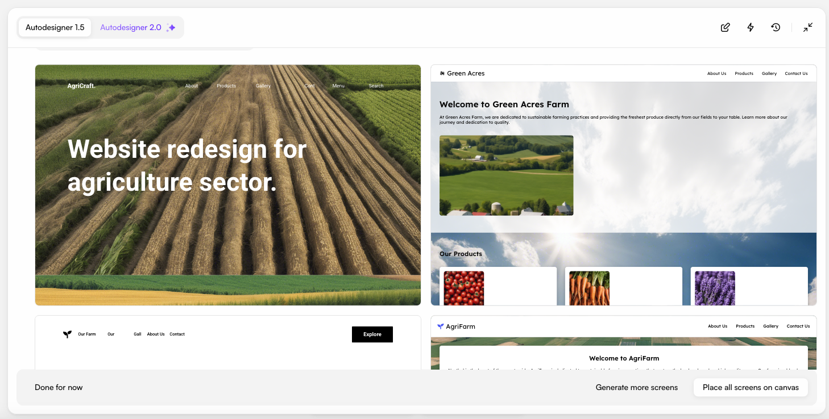
Output

Slide 33
Many other use cases
AI can generate multiple variations of a wireframe or prototype for a single feature, offering diverse approaches to solve a problem.
Prototypes can be generated for different screen sizes and platforms (responsive designs) automatically.
AI can take user or stakeholder feedback and adjust wireframes or prototypes dynamically to incorporate suggestions.
AI can evaluate wireframes for accessibility compliance, such as ensuring color contrast, keyboard navigation, and screen reader support.
AI can quickly translate brainstorming sessions or meeting notes into visual wireframes, making abstract ideas tangible.

Slide 34
Role of Generative AI
in
Frontend / Backend Development

Slide 35
Use case: Create new application
Based on prompt, like Create new React App.
Use tools like GitHub copilot or GPT to generate code
Install VsCode plugin for GitHub CoPilot

Slide 36
Thank You

